Slide 1
Mastering Executive
Presentations
A Synthesis of Contemporary and AI Tools, and Native MS Solutions

Slide 2

Failure of Traditional Coaching
Traditional coaching emphasizes rigid choreography and memorized gestures. This causes severe cognitive overload, compounding the public speaking anxiety (glossophobia) that affects 75% of professionals.
Modern tools abandon "performance" metrics, instead reducing this load through automation and systematic physiological desensitization.

Slide 3
AI Speech Coaching Ecosystems
Asynchronous Analysis
Platforms like Orai and Yoodli act as continuous, unbiased observers in low stakes, private environments.
By tracking variables like words per minute, articulation clarity, and filler word frequency, these tools enable granular mechanical refinement while providing diverse prompts to force neuroplasticity.
Real-Time Intervention
Ambient coaches like Poised operate directly during live virtual meetings on Zoom or Teams.
They provide private, on-the-fly visual nudges (e.g., "slow down" or "increase energy") to bridge the gap between practice and high- stakes performance, systematizing execution across teams.

Slide 4
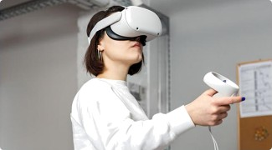
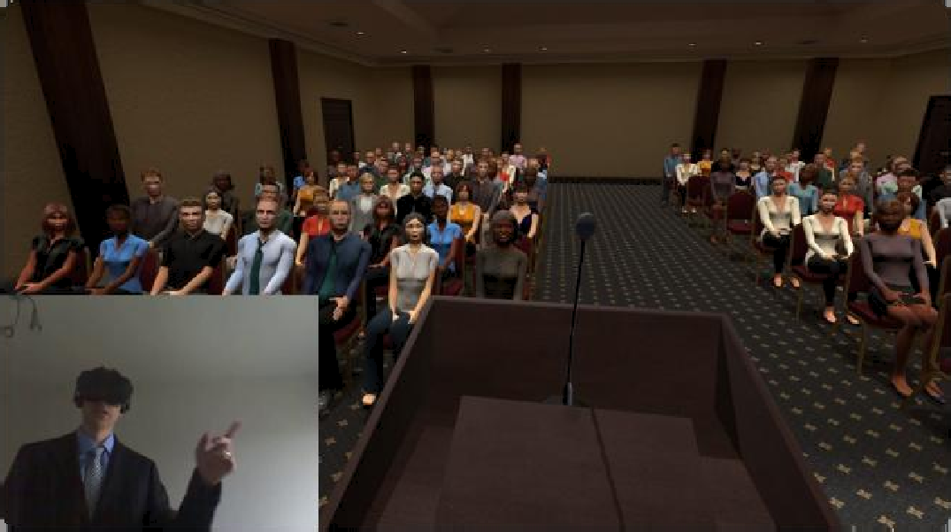
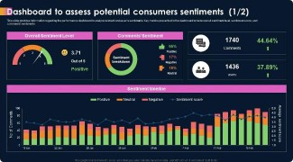


VR Exposure Therapy
Clinical Habituation
VR physically bridges the gap by exposing speakers to realistic, stressful stimuli to lower baseline adrenaline responses.
Realistic Immersion
Plunges users into photo-realistic environments from corporate boardrooms to massive auditorium stages.
Objective Metrics
Provides spatial data human coaches cannot measure, tracking precise eye contact distribution and cadence.

Slide 5

Teams/PowerPoint Speaker Coach
Previously known as Presenter Coach, this powerful AI tool is natively integrated into Microsoft 365 (Web, Windows, Mac). It provides comprehensive, real-time feedback:
Pacing & Pitch Analysis: Warns if you are speaking too fast, too slow, or operating in a monotonous vocal register.
Originality Detection: Actively tracks your voice against slide content, alerting you if you are simply reading the text verbatim.
Inclusive Language: Flags culturally insensitive or non-inclusive terminology in real-time.
Detailed Dashboard: Generates a highly actionable report at the end of your session tracking your improvements.

Slide 6




Advanced PowerPoint Features
Presenter View: The Cognitive Load Reducer
A specialized private dashboard that displays the current slide, upcoming slide, speaker notes, and a running timer. This removes the necessity for total memorization and prevents the speaker from looking back at the screen.
PowerPoint Live: Interactive Virtual Delivery
A massive upgrade over standard screen sharing in Teams. Attendees can navigate slides independently, utilize live translated subtitles, and send live emoji reactions to provide instant feedback on message resonance.
Rehearse Timings: Precise Cadence Management
Automatically records the exact duration spent on each slide during practice, allowing presenters to easily identify dragging sections and optimize their overall timing constraints.
Cameo: Seamless Camera Integration
Allows the presenter to insert their live camera feed directly into the slide geometry, moving beyond the "tiny corner box" and enabling the effective use of hand gestures and facial expressions.

Slide 7
Visual Design Ecosystem
Platform Primary Differentiator Target Audience / Use Case
Zoomable, nonlinear canvas mapping conceptual relationships dynamically.
Live presenters requiring conversational agility.
Prezi
Embeds live polls, Q&A, and word clouds directly into the slide architecture.
Large town halls and interactive workshops.
Mentimeter
Canva /
Visme
Unparalleled asset libraries and robust, data-driven interactive charting.
Brand marketers and complex financial analysts.
VoiceTrack technology scrolls teleprompter in sync with natural vocal cadence.
Executives and content creators recording video.
PromptSmart

Slide 8

The Human Element
Validating Authentic Connection
Despite advanced AI and VR, the human element remains irreplaceable. Over-indexing on algorithms risks creating an "Uncanny Valley" delivery that is mechanically flawless but emotionally sterile.
Localized ecosystems—such as Nairobi Toastmasters clubs and executive coaching institutes—provide the crucial cultural intelligence, emotional empathy, and psychological safety required to validate these newly acquired skills in front of genuine human audiences.

